Slide 1
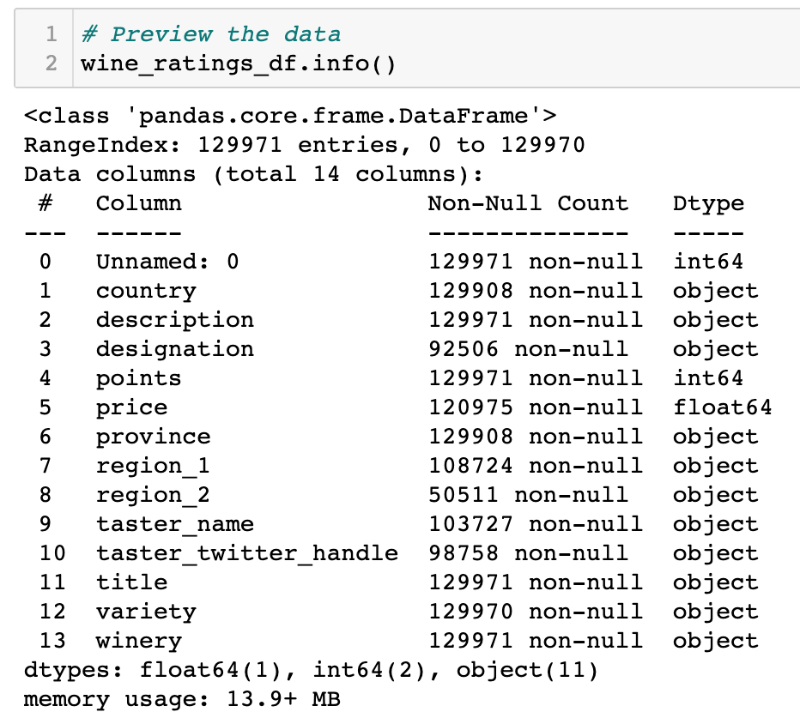
Preview of the 130k Wine Ratings Data
Data Definitions:
Designation = the official type of grape as governed by geographic boundaries
Varietal = the type of wine as determined by the producer
Title = the name of the wine per the label, includes vintage year
NOTES:
Can we pull red vs white out of description to categorize?
Use varietal and remove “designation” column?
Remove null values
Use region_1 and drop region2? Or drop both and use province?
Do we need the reviewers name & twitter handle?
Can we vintage year out of title into own column/category?
Use varietal and remove “designation” column?

Slide 2
Initial Sketch of ERD for Postgres SQL database
Do we need the reviewers name & twitter handle?
PRODUCER
Producer ID
Designation
Winery Name
WINE
Wine ID
Vintage Year
Title (wine name)
Varietal
Price
Description
Rating
REVIEWER
Reviewer ID
Name
Twitter
COUNTRY
Country ID
Province
Region

